Slide 1
Smart Plugs for Building Energy Management Systems
Members name & Id:
Name: Md.Murad Name: Md.Mubassirul Islam Name: Md.Shamsul alam momin
Id:161060042 Id:172007042 Id:171019042
Name: Isse abud hussein Name: Mohamed salah awil
Id:192012042 id: 192026042
Computer science & engineering department
Primeasia university
,Dhaka, Bangladesh .

Slide 2
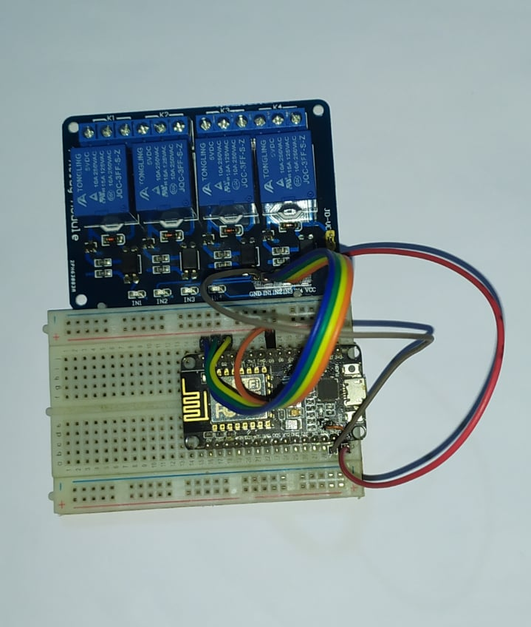
Components:
ESP 8266
4 channel realy module
Connecting wires
Multi plug
Project design:
Working Procedure:
It has a adopter, wifi module, charging usb cable, 4realy.
When we set to ready to start than it work 0.5k to 250v. Its like a home automation system. When we connect light , fan, ac, then it start auto in wifi / Bluetooth/apps etc. we don’t need to using any
Manual switching system.

Slide 3
How to control it?
wifi
Bluetooth
Apps
Ios
Manually
voice
Pseudo code:
Started
Initialize apk
Set BlynkTimer
When v=0
Than started
When v=5
Then turn off
Function start
tmr.setInterval (V0, BlynkMillis()/1000)
while(true)
then
Blynk.run()
and
tmr.run()
end
Working Procedure:
It has a adopter, wifi module, charging usb cable, 4realy.
When we set to ready to start than it work 0.5k to 250v. Its like a home automation system. When we connect light , fan, ac, then it start auto in wifi / Bluetooth/apps etc. we don’t need to using any
Manual switching system.

Slide 4
These are the best smart plugs in future:
iDevices Switch
Currant Smart Outlet
Eufy Smart Plug Mini
iClever Mini
Merkury Innovations Smart Plug
Teckin Mini Smart Socket
Etekcity Voltson WiFi Smart Plug Mini
Gosund Mini
Kasa Smart WiFi Plug Mini by TP-Link
Kasa Smart WiFi Plug w/ Energy Monitoring by TP-Link
Amazon Smart Plug
Leviton Smart WiFi Mini Plug-In Outlet
iHome Control iSP8
iHome Control iSP6
Geeni Switch + Charge Smart WiFi Plug
Geeni Spot Smart WiFi Plug
Belkin Wemo Insight Smart Plug with Energy Monitoring
Elgato Eve Energy
Belkin Wemo Mini Smart Plug

